Slide 1

Life Expectancy: Unpacking the Primary Drivers of a Long Life
Alex Ryan
Catie Lutz
Summer Baptiste
Judy Samuels
Colin O’Neill

Slide 2
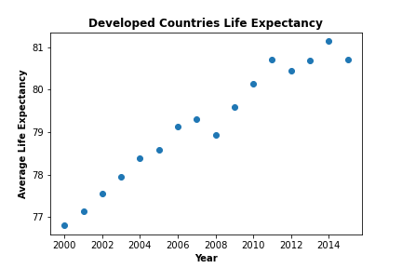
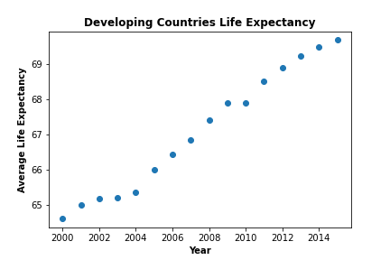
Broad Overview
Notes:
Both average Life Expectancy for developed countries and average life expectancy for developing countries has increased 4-5 years since 2000-2015
Line plots indicate that life expectancy is a bit more random for developed countries (erratic jumps in 2008, 2011, 2014) whereas the life expectancy for developing countries is a smoother linear increase

Slide 3
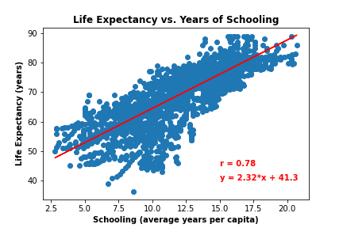
Life Expectancy vs. Education (Consolidated)
Notes:
This slide is looking at Life Expectancy vs. Years of Schooling consolidated
Strong correlation coefficient of .78 suggests strong relationship between a country’s education and its life expectancy
Positive slope and positive correlation coefficient means a direct relationship which is what we would expect

Slide 4
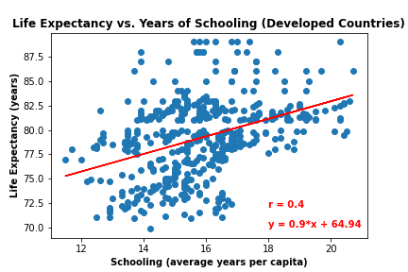
Life Expectancy vs. Education (Developed)
Notes:
This slide is looking at Life Expectancy vs. Education for Developed countries
Weak to moderate correlation coefficient of .4
Weak relationship because Developed countries already have strong health and education sectors. So, we do not see the same strong relationship that we see in the Developing countries chart on the next slide.
Per the first graph, we see life expectancy increasing at a similar rate for both Developed and Developing countries, so it really is the schooling that is slowing in growth compared to Developing countries, which is to be expected as Developed countries already had strong infrastructure in place prior to the 21st century. So no increase like that of developing countries.

Slide 5
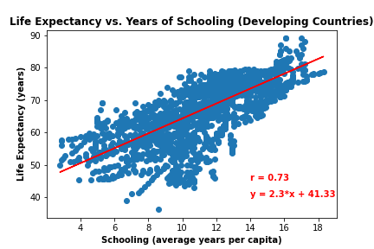
Life Expectancy vs. Education (Developing)
Notes:
This slide is looking at life expectancy vs schooling for Developing countries
Strong correlation coefficient and positive linear relationship
Potential confounding variables – as a country strives for development, education and health will improve independent of each other but both will show improvements over time

